Slide 1
UR 2 Robotic Arm Project Daniel Oliver

Slide 2
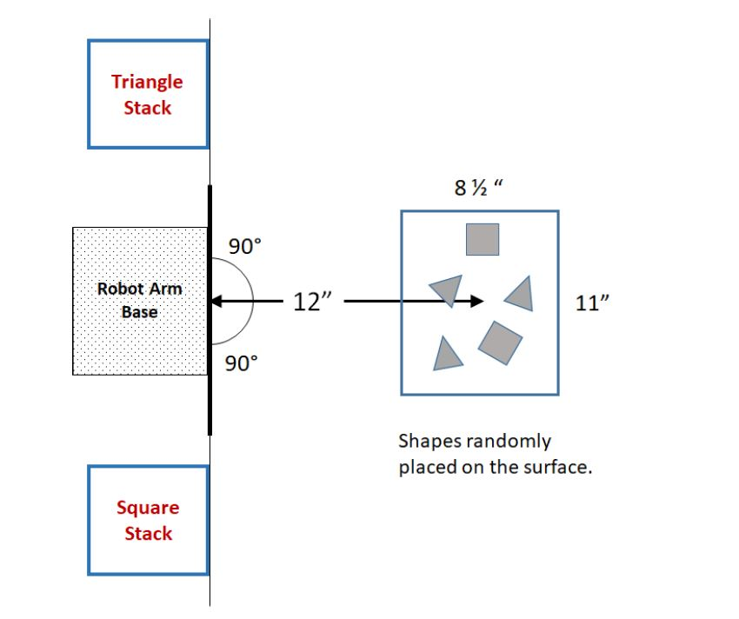
Project objective description
Identify 2-inch triangular or square steel plate parts placed on white surface 12” away.
Move plates to two different stacks at a 90° angle from the original location.

Slide 3
Literature Review and Market Research
For pick and place applications robotic arms often utilize a computer vision system.
The vision system allows the arm to effectively get to the desired object and then move it to the proper location.
Common applications of vision guided robots are
Loading/unloading parts from conveyors and feeding systems
Loading/unloading nested parts from trays or boxes
Part placement, assembly and packaging
Racking and de-racking
Palletizing and de-palletizing
Bin picking of random parts
Notes:
https://www.visiononline.org/blog-article.cfm/Vision-Guided-Robotics-for-Pick-and-Place-Applications/71

Slide 4
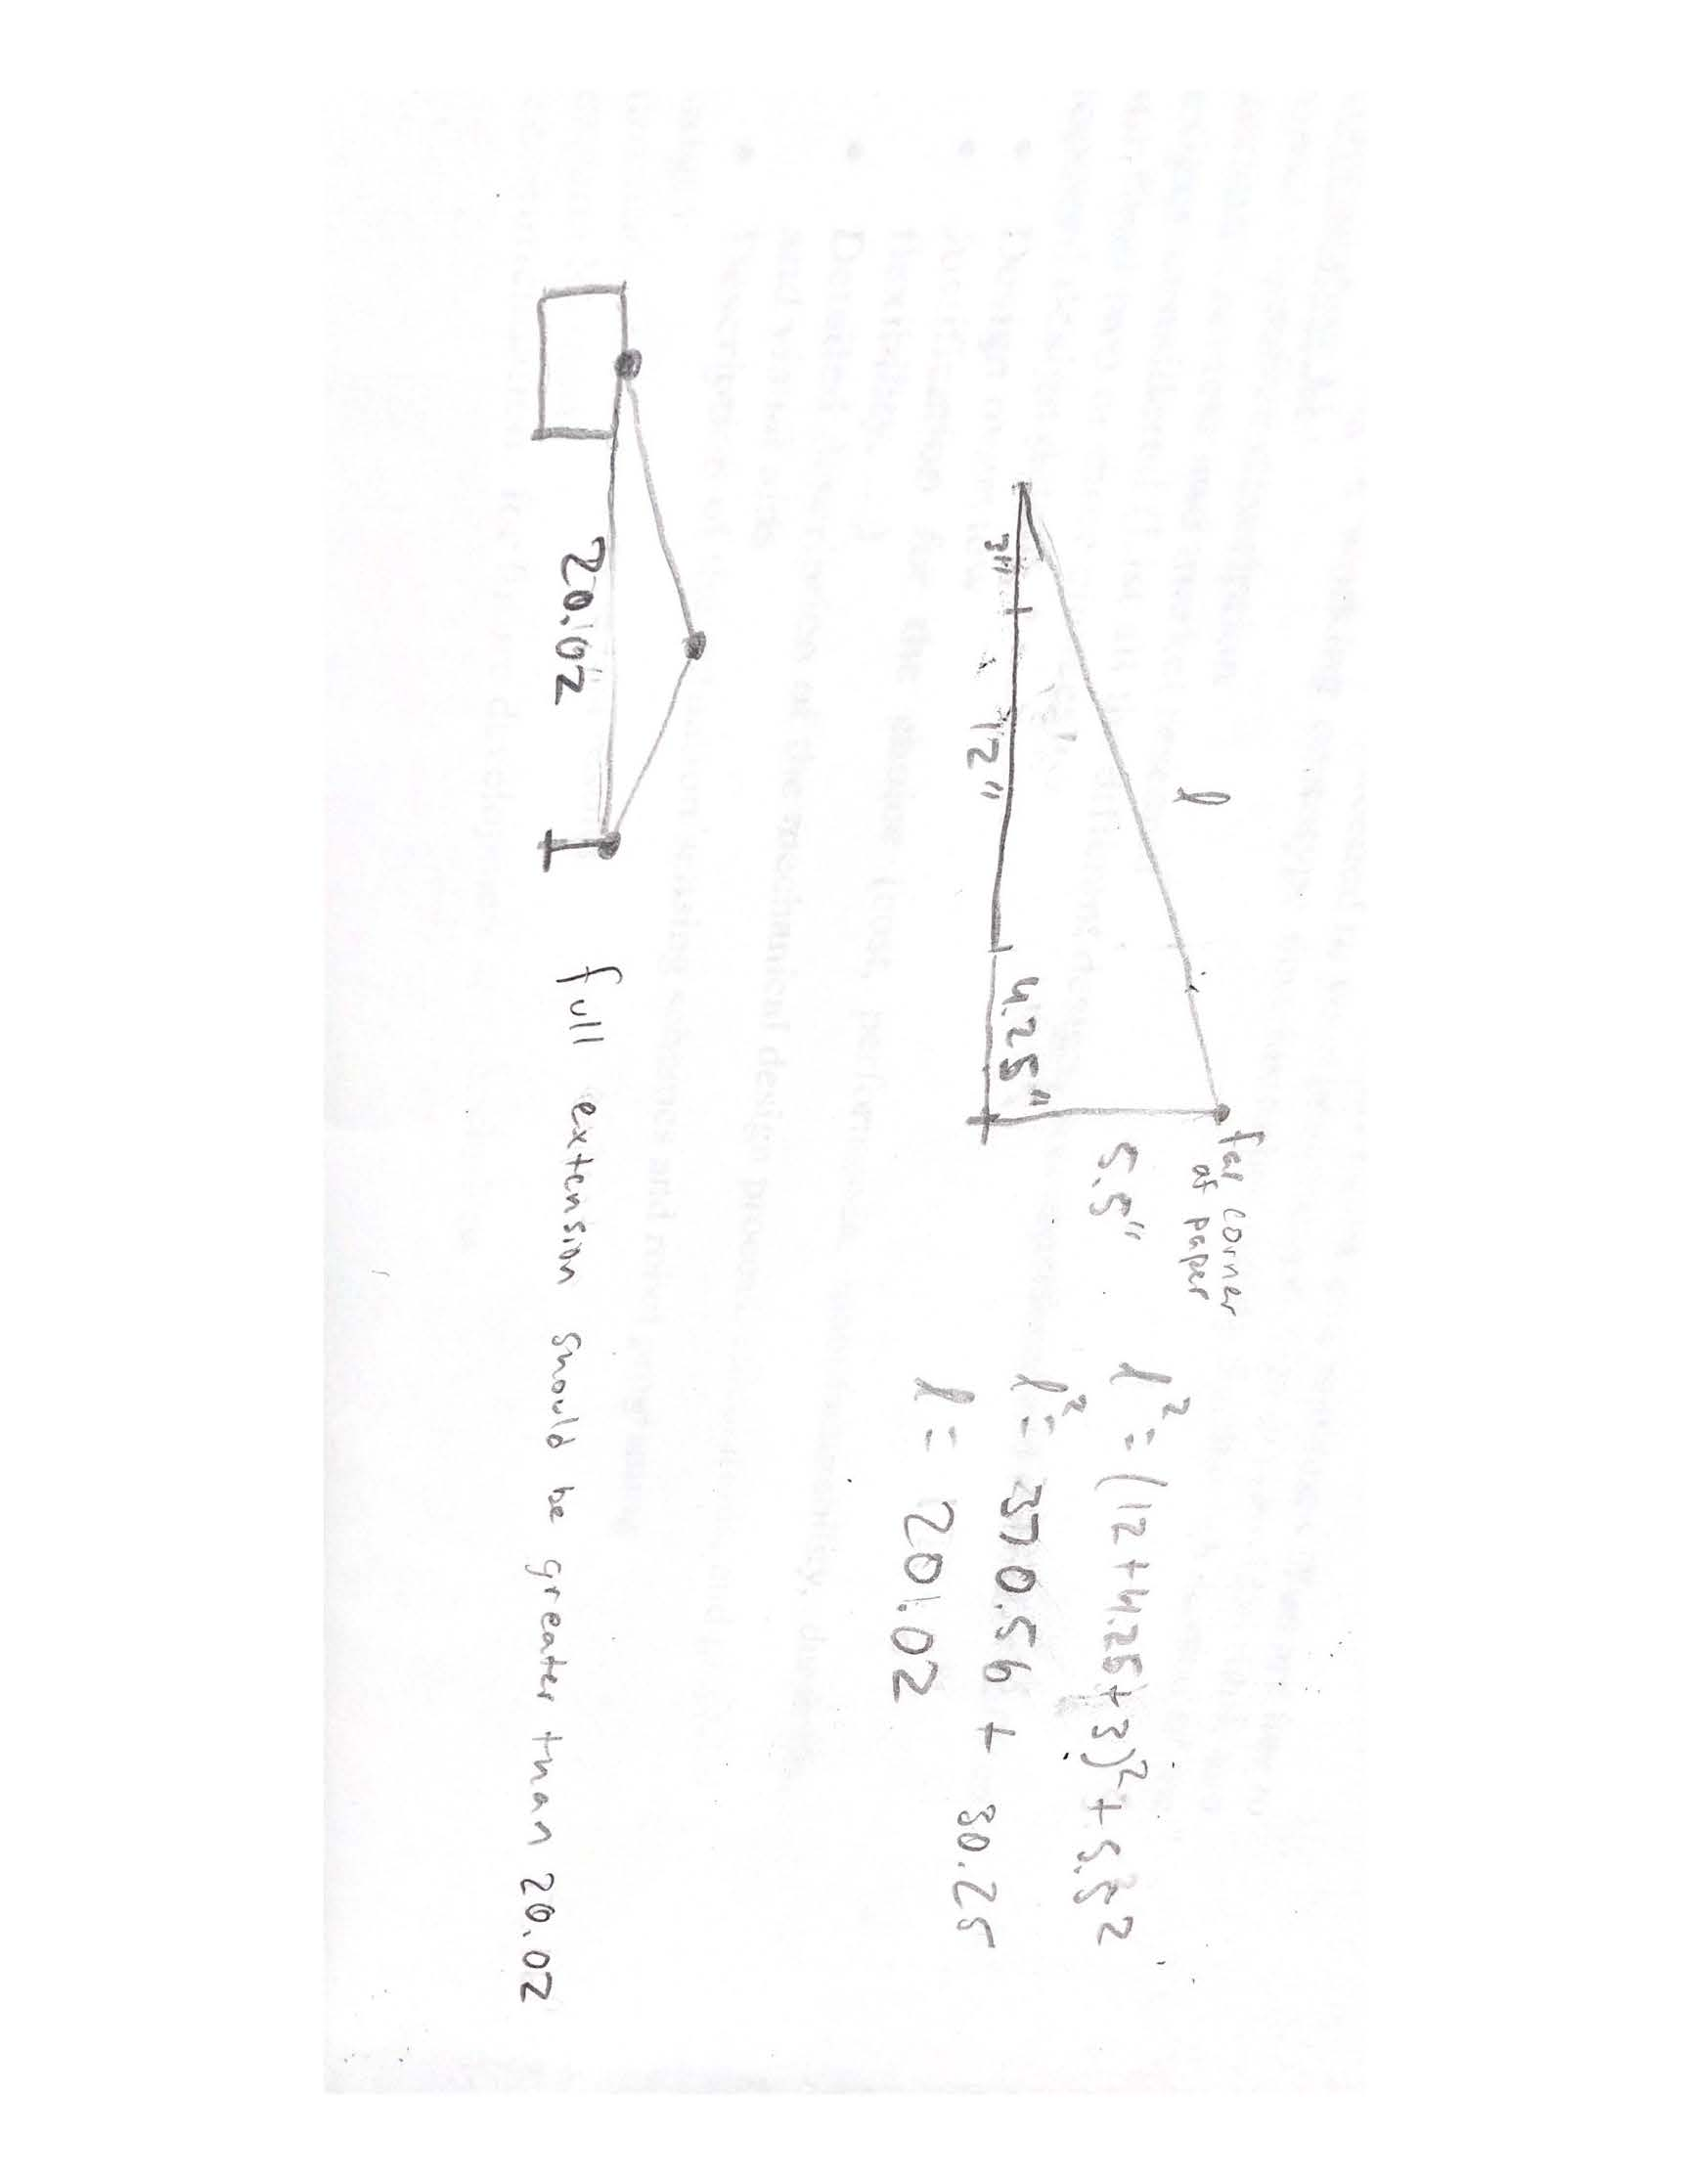
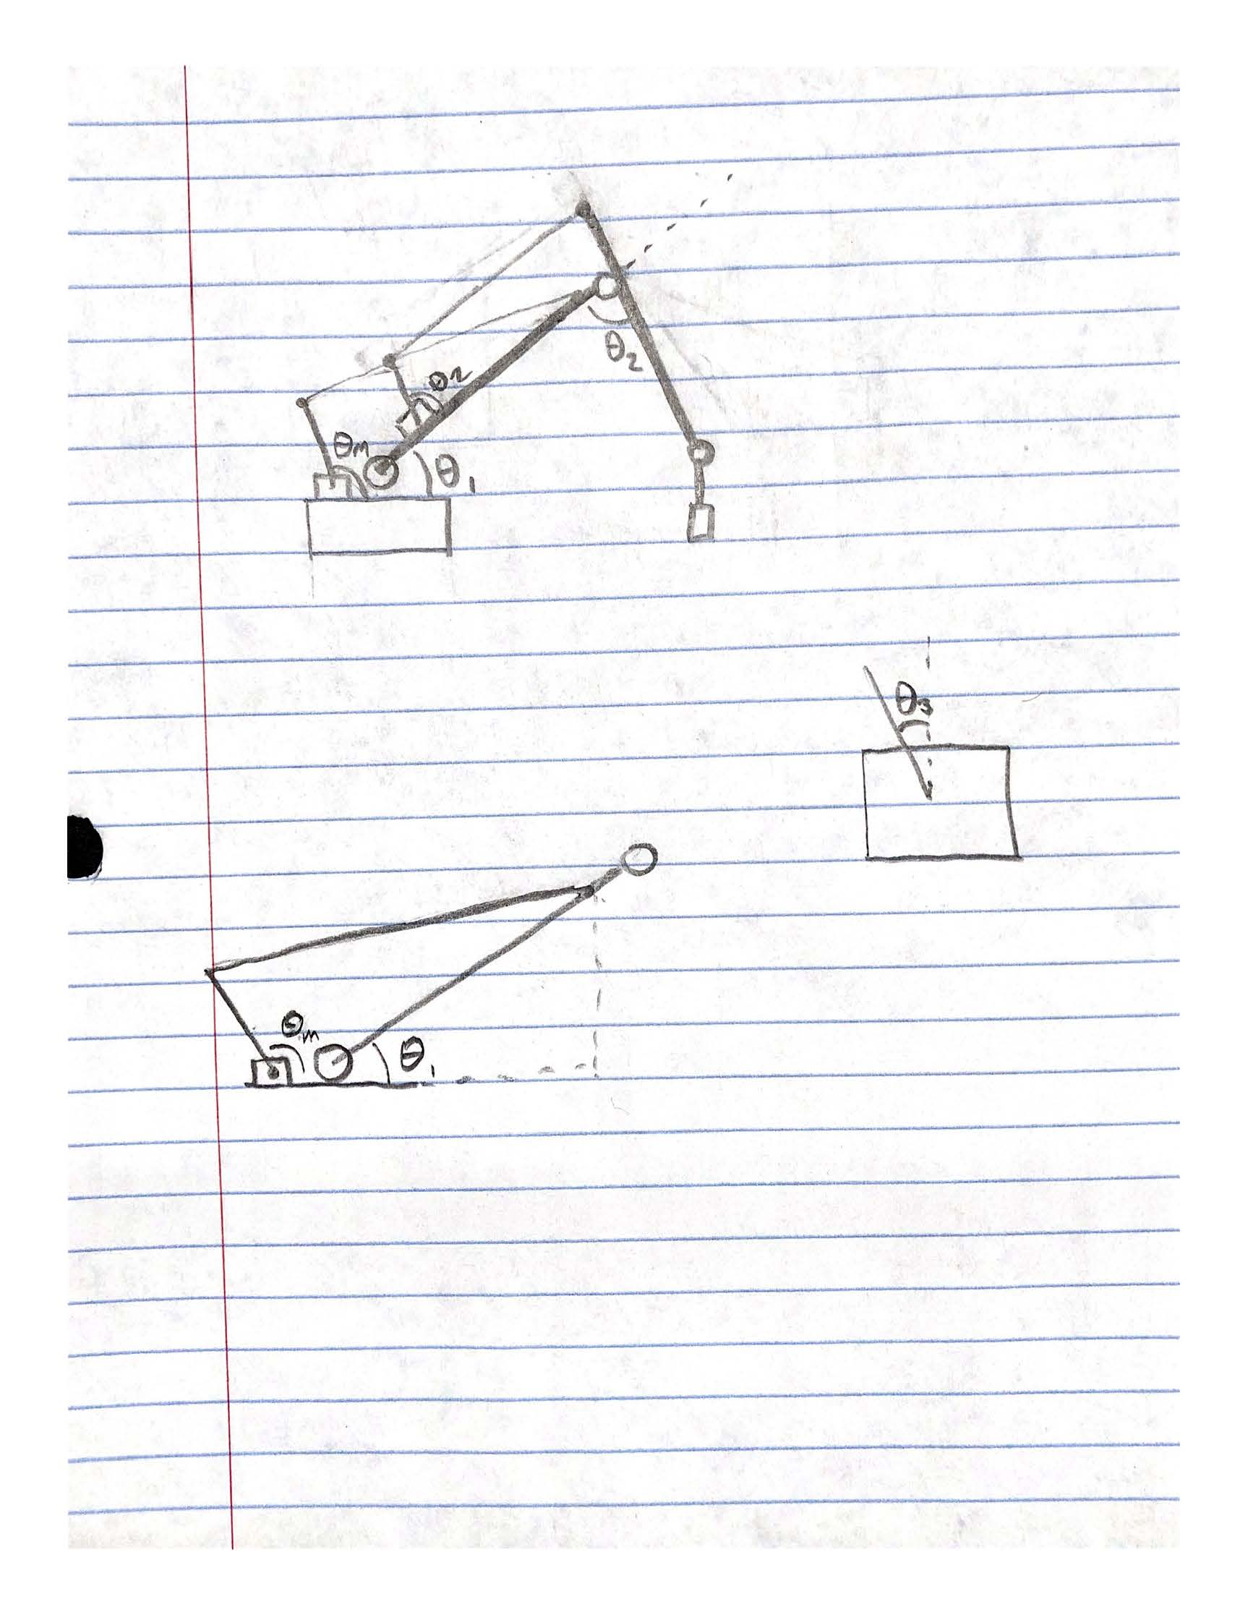
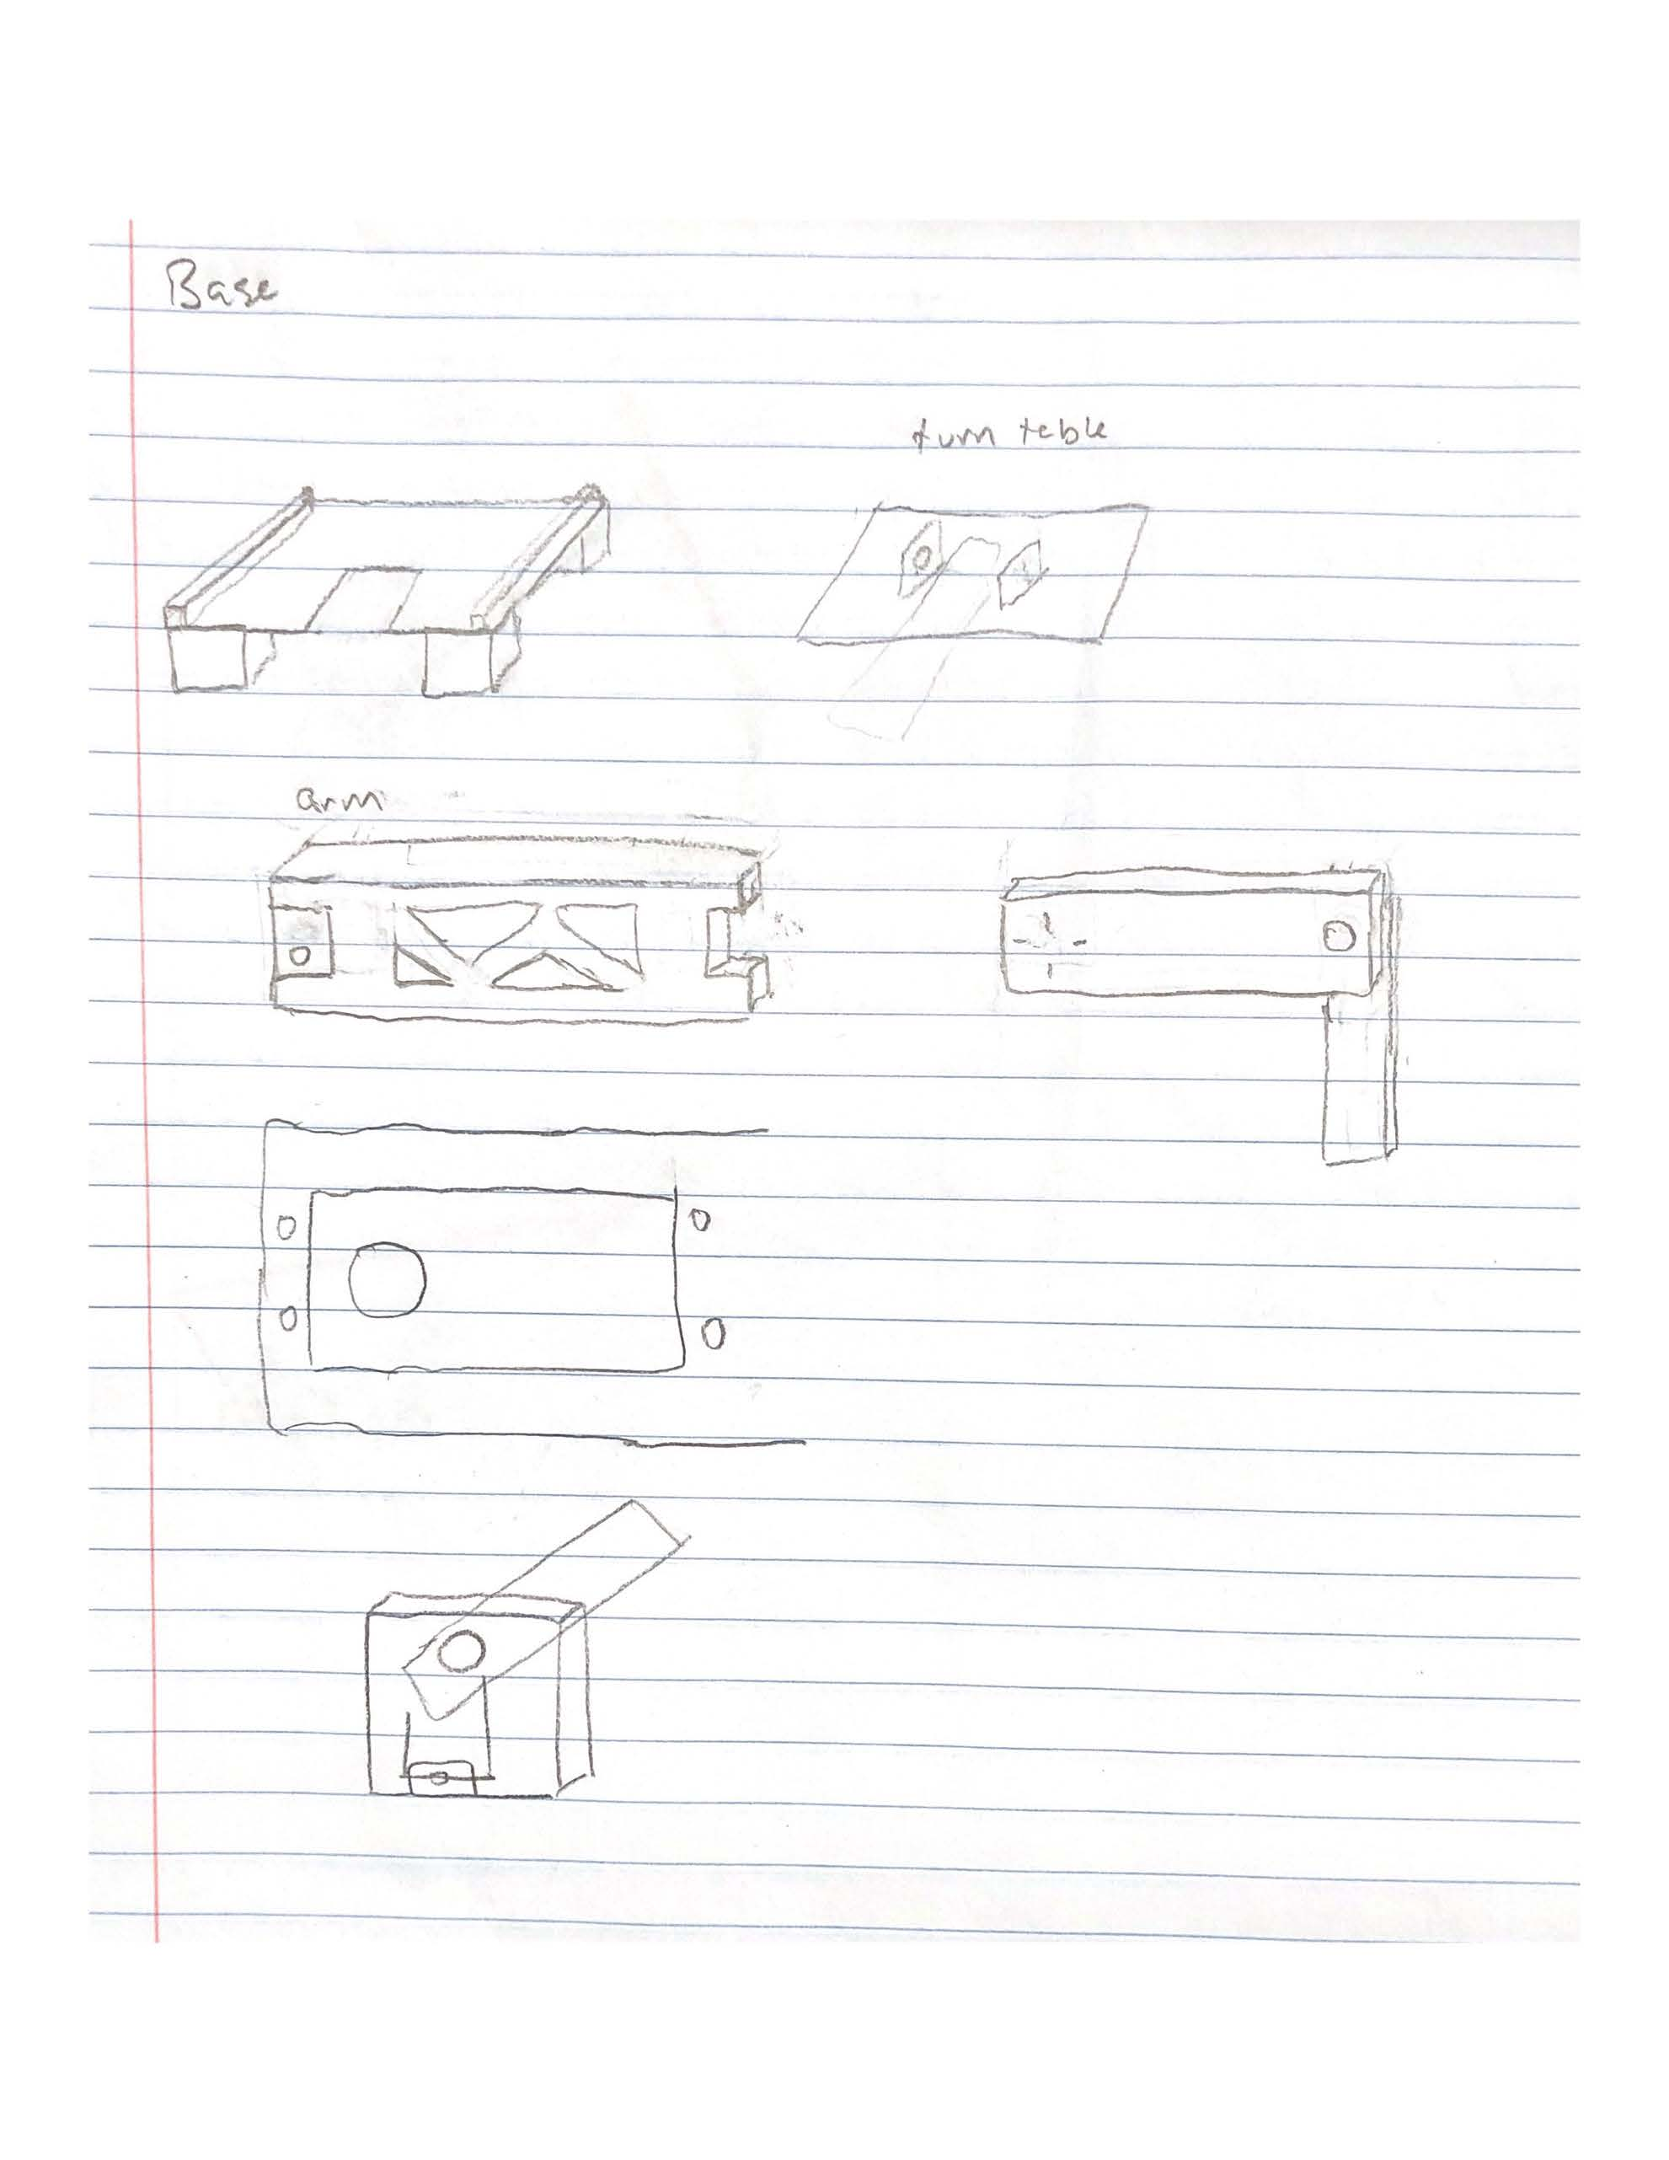
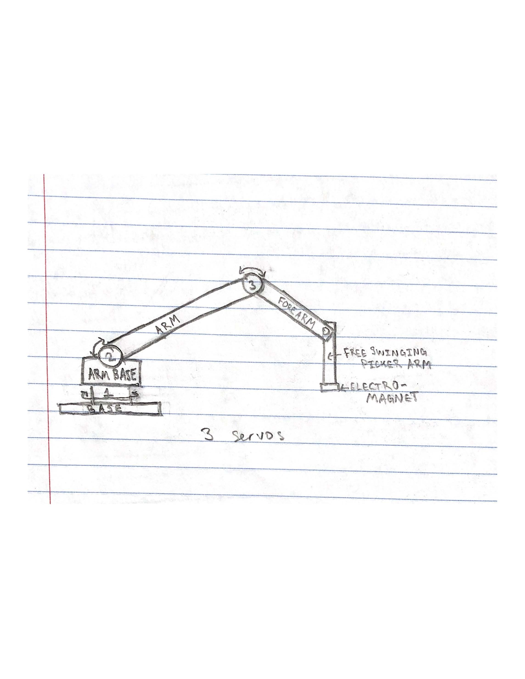
Designs Considered
Initial designs

Slide 5
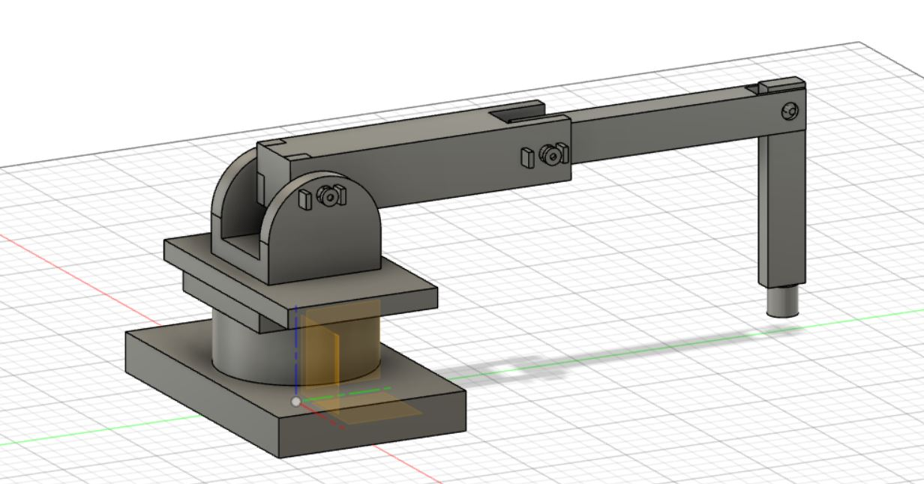
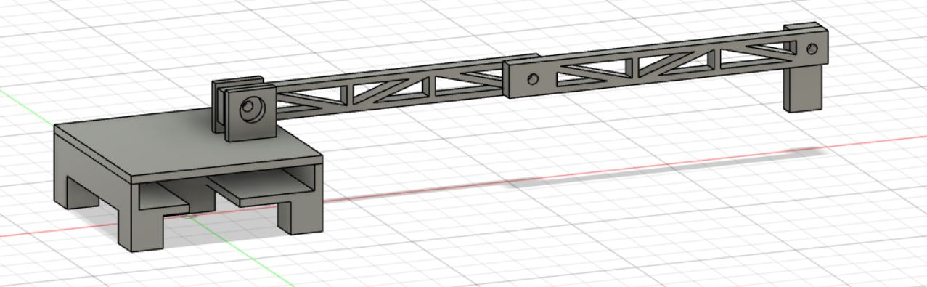
Designs Considered
Initial CAD Model
Second CAD Model

Slide 6
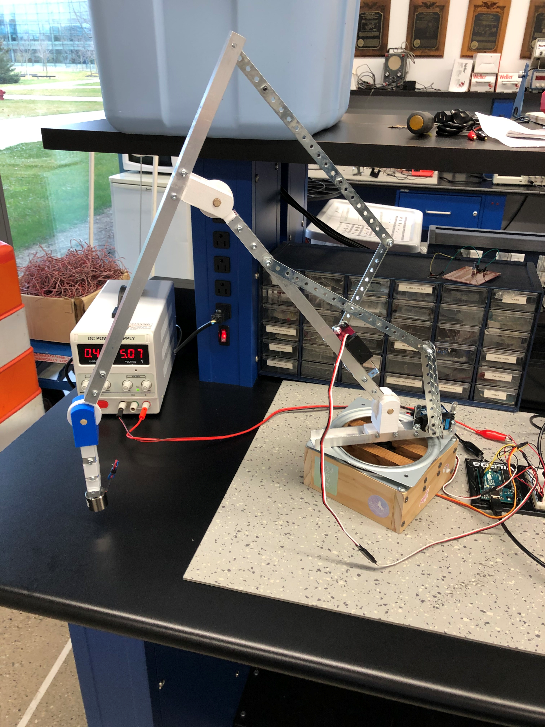
Proposed Design
Final design

Slide 7
Budget
12 kg servo motor: $5.25
20 kg servo motor: $13.50
35 kg servo motor: $38.99
Electro magnet: $9.29
6” turn table: $6.49
Webcam: already had
Total: $91.51
Bearings: $0.60 (x3)
Metal servo horn: $1.40 (x3)
U-channel: $11.99
3D printed joints: $
Wood: already had
Erector set parts: already had

Slide 8
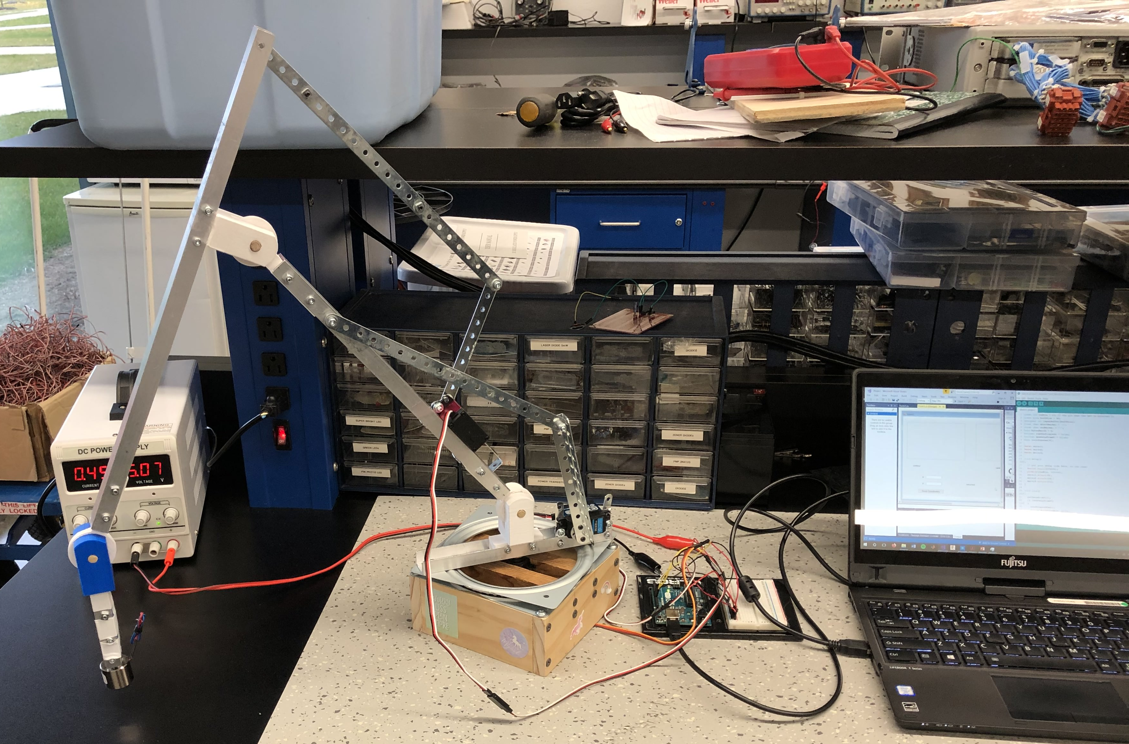
Summary of Design
Wooden base with turn table.
3D printed joints
Aluminum U-channel arm linkages
Erector set used for lever arms

Slide 9
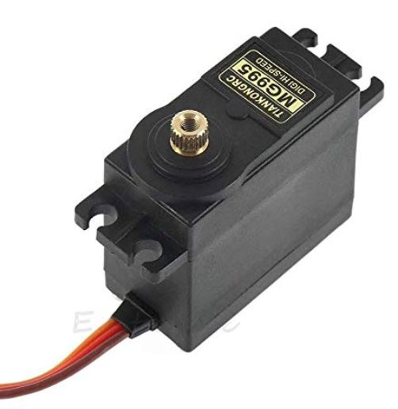
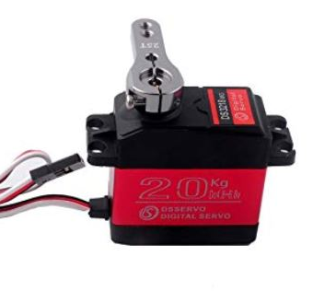
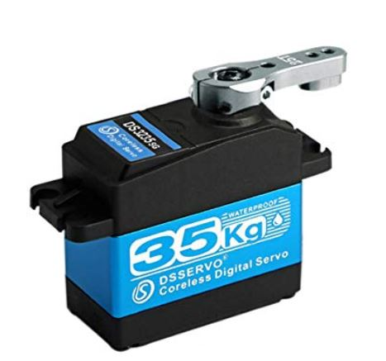
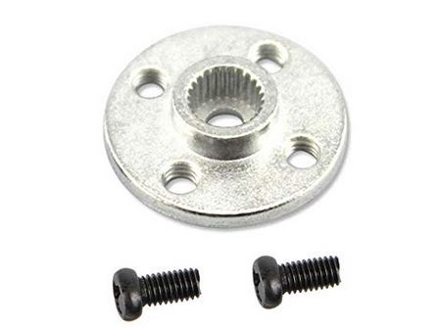
Summary of Design
Motors
12kg/cm for the base rotation
20kg/cm for the second link
35kg/cm for the third link
Aluminum servo horns for attaching motors to the pivot arm.

Slide 10
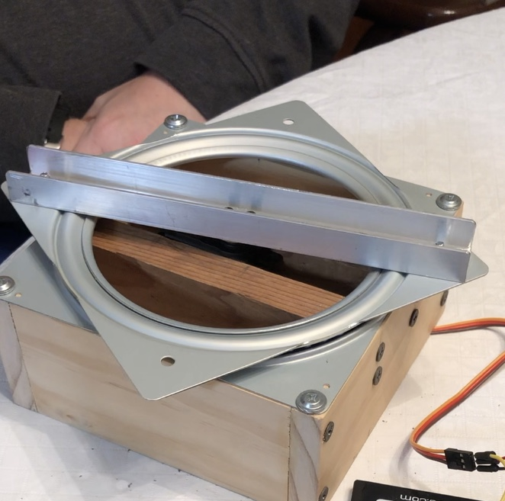
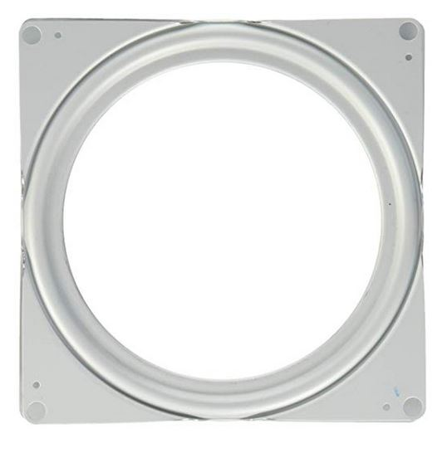
Summary of Design
Base
Wooden base
6” turn table

Slide 11
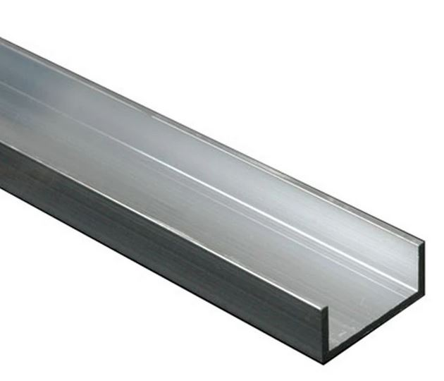
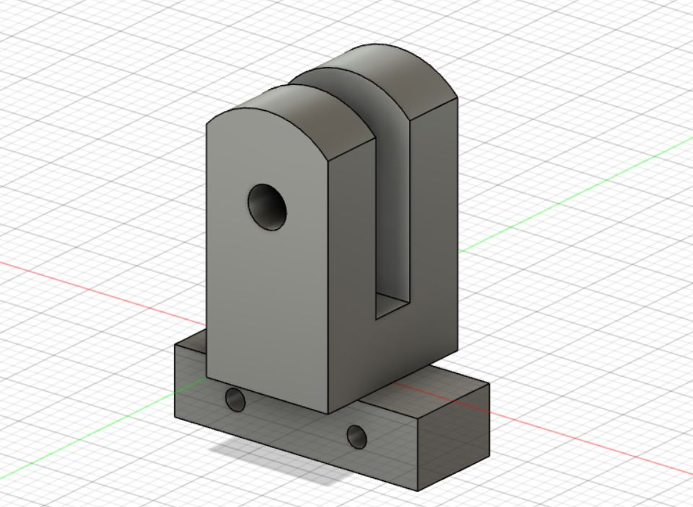
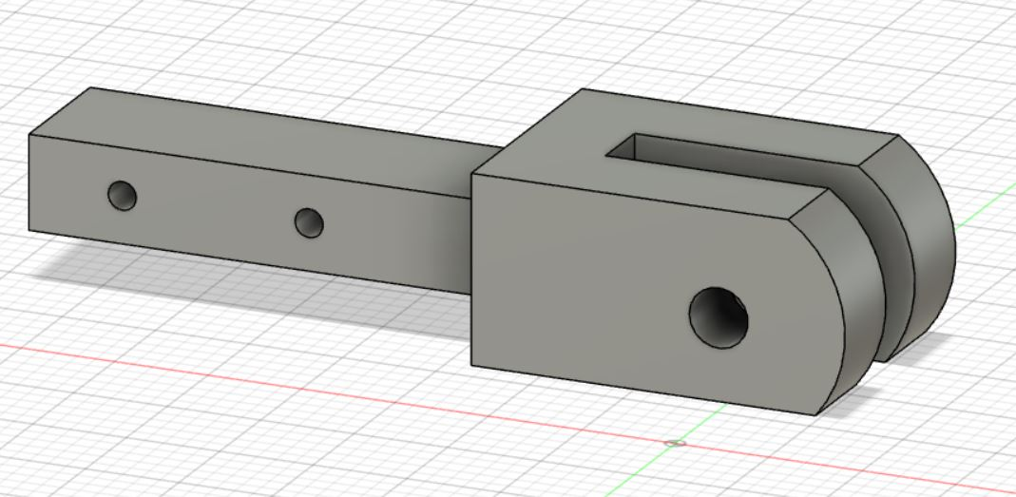
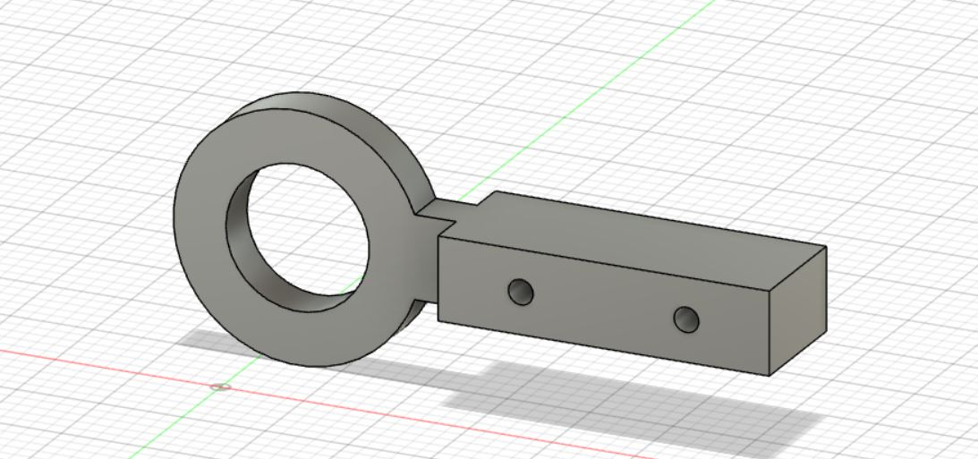
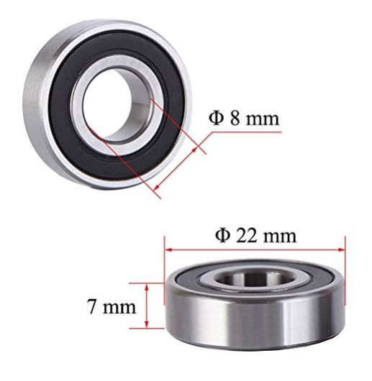
Summary of Design
Arm linkages
U-channel used for arm linkages
3D printed joints
22 mm bearings
9/16” dowel

Slide 12
Lessons Learned
EmguCV for shape detection
Arduino control for servos
Equations of motion of a two link robot arm

Slide 13
Recommendations for future development and conclusions
Try to minimize the complexity of your kinematics
Try to reduce weight of robot arms
Add counterweight to reduce base movement.

